Slide 1
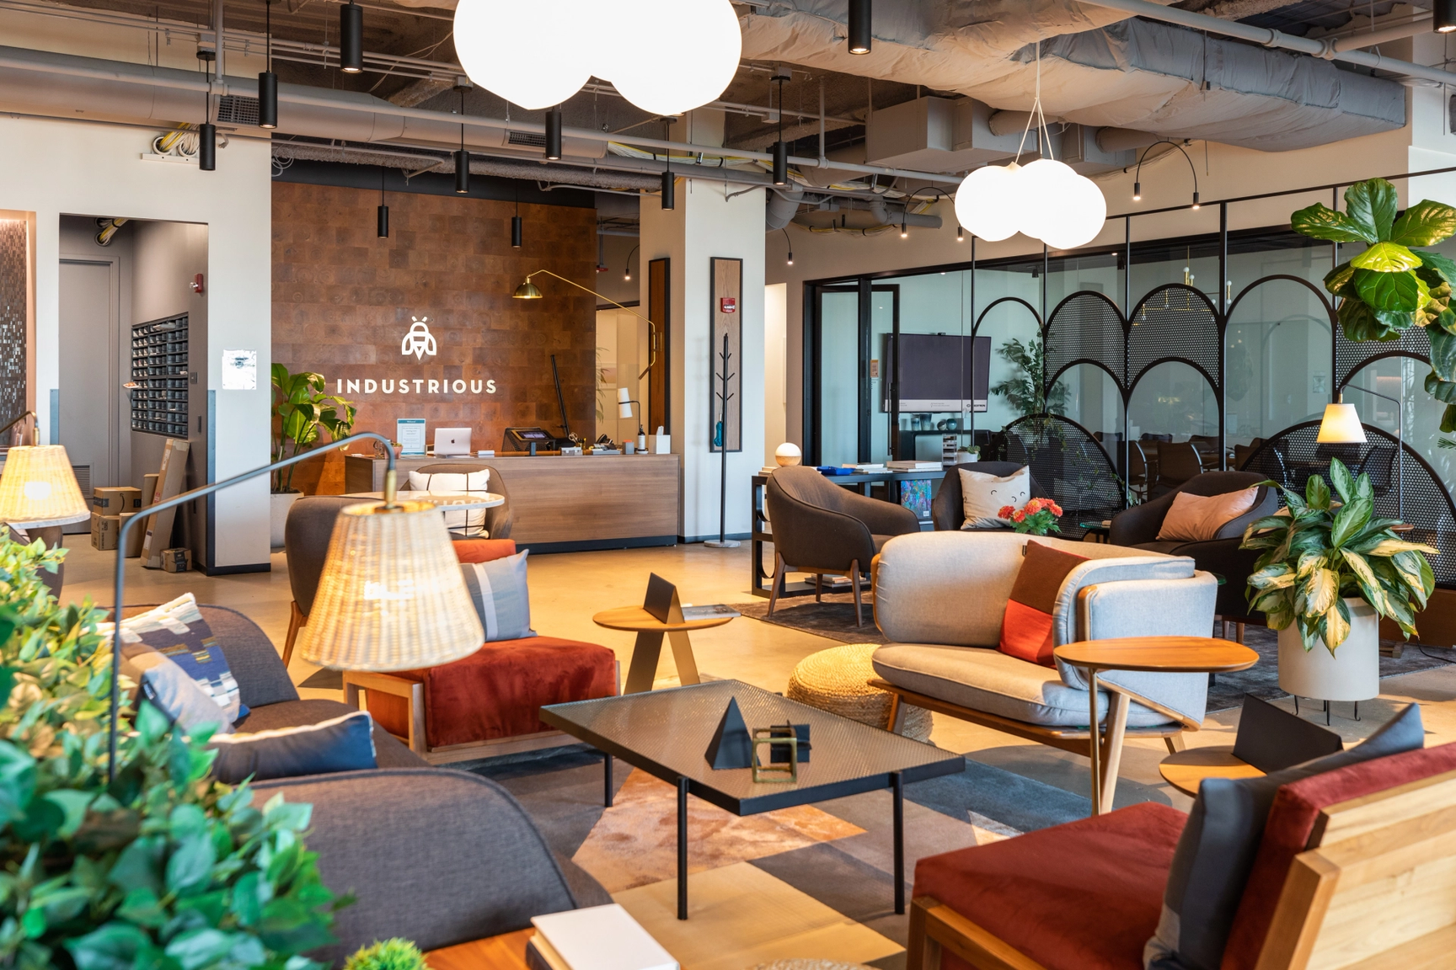


FORESIGHT & STRATEGIC DESIGN
By Vinayak Singh

Slide 2

Executive Summary
Business Model Archetype
FLEXIBLE AND HOSPITALITY-DRIVEN WORKSPACES : Creating employee-centered, service-oriented workplaces that combine the flexibility of coworking with the consistency and professionalism of hospitality operations.
Company
Industrious, founded in 2012 by Jamie Hodari and Justin Stewart, is a leading global coworking operator providing premium, flexible offices through partnerships with landlords.The company operates 160+ locations across 65+ cities worldwide and was acquired by CBRE for nearly $1 billion in 2025, validating its strategic and financial strength.
Is the business model financially viable and scalable ?
Is Industrious operating in a favorable and growing external environment ?
Global coworking market projected to grow from $45B (2025) to $136B by 2032.
55% of large occupiers use flexible offices; 17% plan to increase usage.
Supportive regulations: recovery funds, hybrid work policies, and ESG-driven workplace goals.
Answer to Hypothesis
Industrious shows that a hospitality-driven, asset-light coworking model can scale profitably while maintaining lower per-user environmental impact. Its partnership approach supports high occupancy, stable retention, and reduced reliance on new construction. At the same time, its focus on design quality and wellbeing contributes to positive social outcomes for members. Overall, Industrious provides evidence that flexible workspace operators can balance profitability, resource efficiency, and employee wellbeing as they grow through management agreements rather than fixed leases.
Does Industrious have the internal model and performance to deliver viable and scalable growth?
~90% occupancy for mature units (vs. industry benchmark 70–85%).
25% higher revenue than main competitor; NPS 74–82%, indicating top satisfaction levels.
Management agreements with landlords lower fixed costs and enable fast replication.
60–80% annual retention rate, stable occupancy despite monthly volatility.
Backed by CBRE acquisition, providing capital, due diligence, and global scaling leverage.
Does it qualify as a net positive catalyst ?
How does Industrious reduce its environmental footprint?
49 kg CO₂e/m² (traditional) vs. 11 kg CO₂e/m² (flex) —shared spaces cut emissions per user.
70% of sites in green-certified buildings; retrofit preferred over new build.
Use of low-carbon materials, LED, bamboo, and recycled furniture.
How does Industrious embed sustainability into its operations and culture?
First coworking provider with the WELL Coworking Rating (London & Manchester).
0.71 correlation between atmosphere and satisfaction; +79% service quality impact.
Enhanced wellbeing, autonomy, and belonging compared to traditional offices.
How does Industrious act as a systemic catalyst for a net positive future?
Shared model enables ~40% cost savings per company vs. traditional leases.
20% lower operational costs via technology and centralized management.
NPS 82% across 40,000 members and campaigns like “Industrious You”

Slide 3
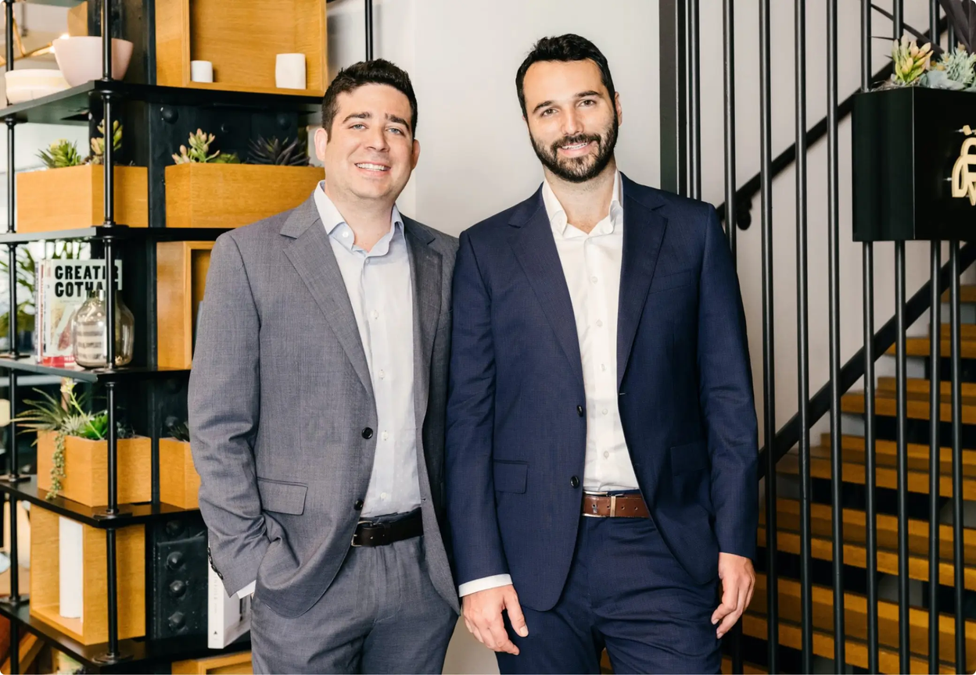
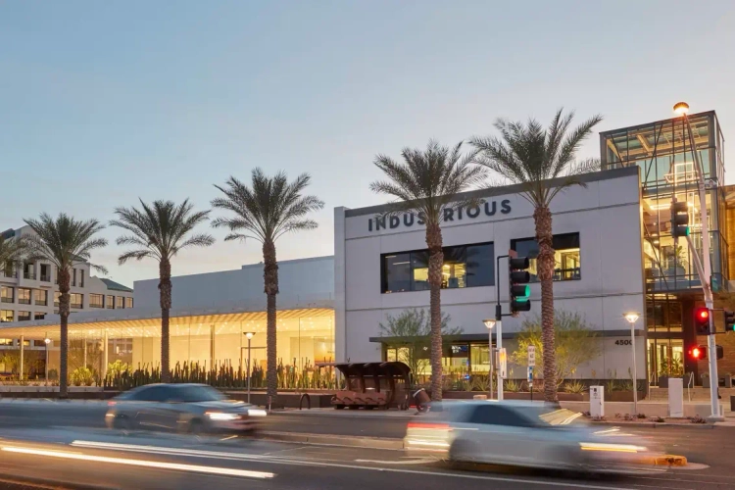
FOUNDERS’ STORY
Jamie Hodari & Justin Stewart
Founded in 2012 by childhood friends Jamie Hodari and Justin Stewart.
Motivated by frustration with coworking spaces where client meetings went better in hotel lobbies and coffee shops rather than in their own coworking offices.
MISSION
Create a new kind of workplace centered on employee’s needs.
Empower people to choose where and how they work.
Provide spaces that help businesses move forward by enabling focus, collaboration, and pride in the workplace.
CORE CONCEPTS
Flexible workspaces for companies of all sizes and stages.
Adaptable spaces to meet evolving business needs.
Seamless service that removes distractions from everyday operations.

Slide 4
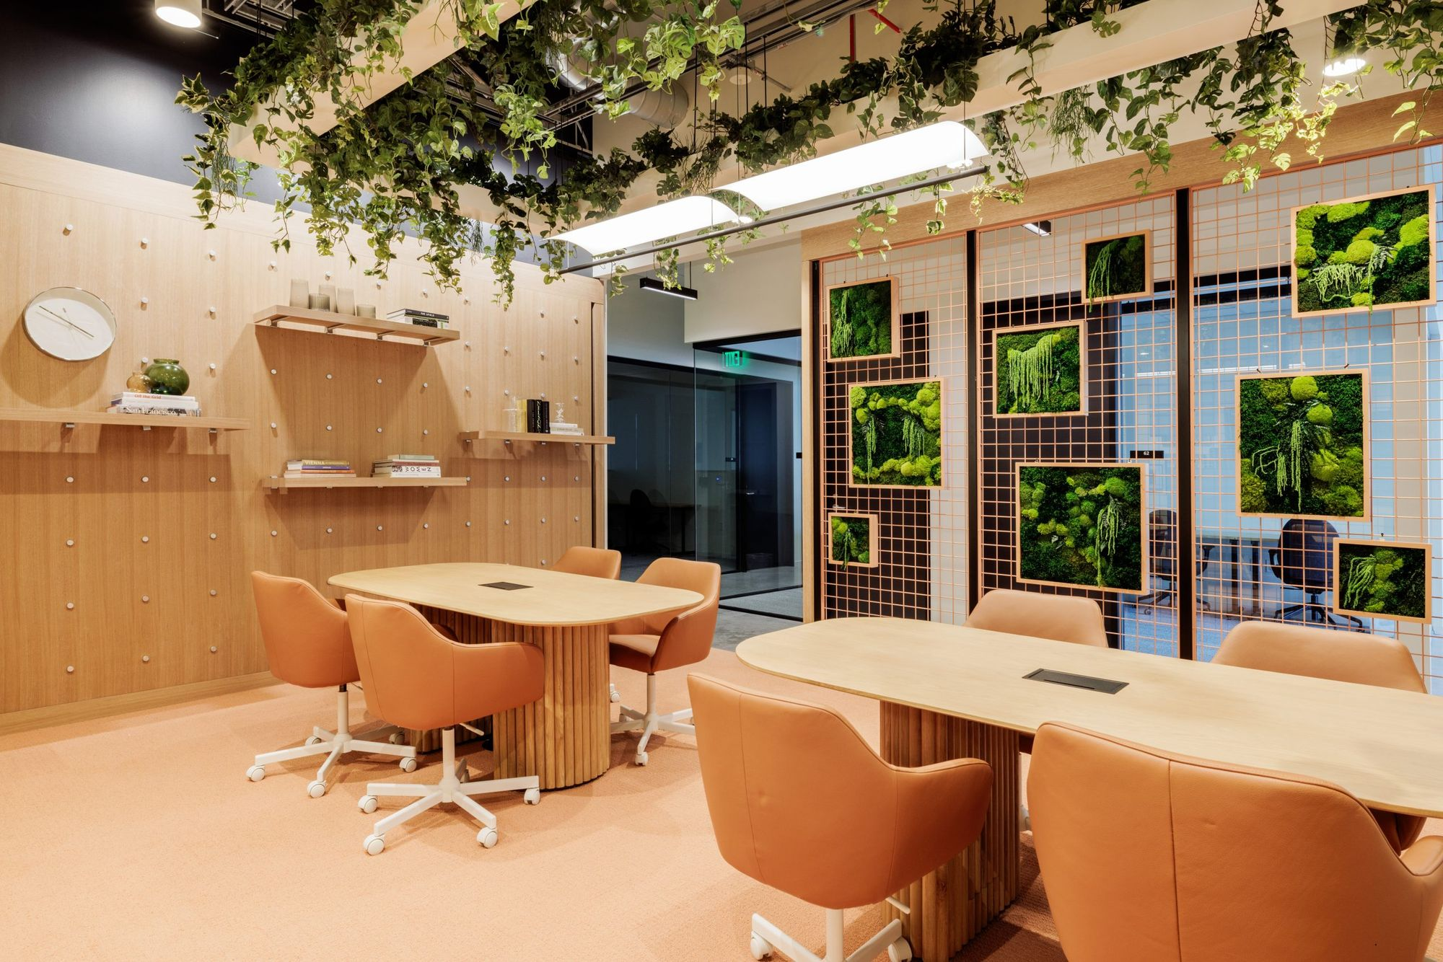

2012
2013
2025
TWO friends
ONE idea
80 investors
$1 million
20,000 sq.ft.
1 property
in Chicago
100% occupancy
160+
locations
65+
cities globally
#1
customer satisfaction

Slide 5
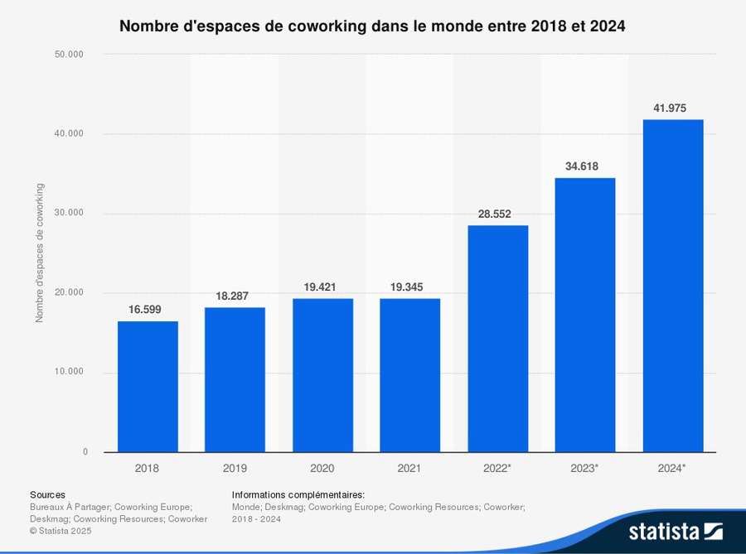
FINANCIAL VIABILITY
An expanding market
Financial Viability Requirement | Industrious Evidence supported
Profitable growth segment | Flexible office/rent segment is fast growing
Strategic investor validation | CBRE Group Major Acquisition
Market Trend alignment | Office space shift to hybrid/co-working
Insitutional Due diligence | CBRE’s financial & operational vetting
Financial viability is unequivocally proven: Industrious operate within a highly profitable growth segment, aligned with the macro shift toward hybrid work, as demonstrated by the $5 trillion market forecast by 2030. This model has been strategically validated by the world's largest commercial real estate firm, CBRE, which acquired Industrious for nearly $1 billion. This acquisition provides powerful institutional backing and market credibility, though it presents the operational challenge of potentially losing the agility vital to a fast-growing, innovative segment.
Notes:
the acquisition of Industrious is a great indicator towards the viability of this model, in fact we observ the fair value of the company estimated to be only $270M, in other terms, CBRE paid an extra $574M to acquire this coworking business.
Thanks to CBRE they can now rely on a great backup as they show on their balance sheet a total of assets nearing $26.4 bn.

Slide 6
ISSUE ANALYSIS
Scalability & Viability Assessment
Is Industrious a viable and scalable business model in the space-as-service industry ?
Is Industrious operating in a favorable and growing external environment?
Does Industrious have the internal model and performance to deliver viable and scalable growth?
Does the coworking model generate higher profitability compared to traditional office leases ?
Does demand for flexible workspace continue to grow in major urban markets?
Can operators replicate the model efficiently across multiple cities and regions ?
Do customer satisfaction levels translate into higher revenue per member?
Can operators maintain strong member retention rates over time?
Are occupancy rates sufficient to cover fixed and variable costs across sites?
Market Demand
Scalability potential
Customer Retention
Competition
Customer Satisfaction
Occupancy rates
Demand is still growing in major urban markets (companies seeking shorter leases to stay agile and individuals valuing well-located)
Operators can replicate the model across cities if they standardize operations and adapt to local costs and rules
Unlike traditional renting, the coworking model has to make sure that the retention rate is high so that they have sustained profits
Coworking operators leases higher per-square-foot rate than traditional leases and more financially viable
If customers are happy with a service, they would be ready to pay more for it.
Some periodic trends might affects the occupancy rates thus the overall revenue.
55% of large occupiers use flexible offices, 17% plan to increase usage.
Forecast of flexible offices : $45 billion in 2025 to $136 billion by 2032
Partnering with landlords lowers fixed costs and expansion risks → Efficient replication of the coworking.
Adaptation to local market conditions.
25% higher revenue than largest competitor
Highest customer satisfaction rating (74% NPS score)
Strong growth, asset-light business model
Average coworking desk rates higher than traditional ones (160 $/sqm vs. 60 $/sqm)
Higher revenue but NOI margin can be lower (high costs) ⟶ fragile profitability
Average retention rates from 60% to 80% annually
Unstable monthly revenues → risks (marketing to maintain a high occupancy)
90% occupancy rate
Above industry benchmark (70-85%)
Strong financial viability

Slide 7
KEY RESULTS
Scalability & Viability Assessment
Business Model for Industrious
Problem
Solution
Value Proposition
Unfair Advantage
Customer Segments
Turnkey, Scalable Hybrid Ecosystem: Provides wellness-focused environments and advanced technology (booking/analytics) to seamlessly manage and scale client hybrid workforces.
Community-oriented environments with wellness-focused features to boost engagement and productivity.
Advanced technology platform for booking, analytics, and hybrid workforce management.
Professional services for workspace design, operations, and member support.
Proprietary Tech & Institutional Backing: Leveraging in-house technology for member management, validated by CBRE's acquisition, providing unique market credibility and accelerated, capital-light expansion.
Recognized brand for quality and hospitality in flexible office space.
Scalable network and experience in operational excellence across cities.
Complexity of Hybrid Work: Enterprises struggle to manage complex, data-driven hybrid work models necessary to boost productivity and employee satisfaction.
Businesses struggle to foster community, engagement, and productivity in outdated workspaces.
Managing and optimizing hybrid work models is complex for enterprise clients.
Lack of data-driven insights into workspace usage and employee satisfaction
Premium Workplace-as-a-Service: Delivers predictable, cost-efficient, and hospitality-centered environments that specifically attract and retain enterprise talent.
Predictable & transparent cost structure
Wellness & hospitality-centered community
Industry leading technology for easy management and analytics
Networking events and branded experiences
High-Value Enterprise & Distributed Teams: Focus on large clients requiring customized, scalable solutions and data-driven insights to manage their hybrid workforce.​
Enterprise clients needing scalable, customized office solutions and data-driven management.​
Startups and entrepreneurs looking for collaborative community and networking benefits.​
Remote workers and freelancers seeking access to high-quality workspaces on demand.​
Teams focused on wellness, productivity, and hospitality in their work environment.​
Event organizers and professionals needing short-term or day-use premium spaces.​
Channels
Direct sales team targeting enterprises and SMBs.
Digital marketing through website and social media platforms.
Partnerships with commercial real estate brokers.
Technology integrations and referral programs
Key Metrics
Retention & Lifetime Value (LTV): Prioritizes Member Satisfaction/Renewal Rates and Enterprise Expansion Deals to validate service quality and secure long-term revenue.
Enterprise memberships and expansion deals.
Revenue per workspace and overall profitability.
Cost Structure
Revenue
High Service Cost: Costs are driven by salaries for high-caliber staff (community managers), which is a necessary operational expense to deliver the premium service quality.
Maintenance, utilities, cleaning, IT infrastructure
Space refurbishment, technology platform, marketing
Membership/subscription fees (private offices, dedicated desks, hot desks)
Enterprise contracts (customized solutions for large companies)
Predictable Enterprise Subscriptions: Focus on recurring revenue from customized enterprise contracts (MRR) over volatile event rentals and day passes.
Conclusion: Industrious strategically uses an asset-light, high-touch service model to command premium pricing from enterprise clients. Its success hinges on balancing the high cost of personalized service against the volume required to overcome inherently thinner margins from its partnership-based real estate model.

Slide 8
VALUE CHAIN
Scalability & Viability Assessment
Support Activities
Primary Activities
Firm Infrastructure
Asset-light structure with revenue-sharing management agreements.
Backed by CBRE’s financial strength and institutional due diligence.
Strong governance, strategic planning, and expansion capabilities.
INBOUD LOGISTICS
OPERATIONS
OUTBOUND LOGISTICS
MARKETING & SALES
SERVICES
Selection of premium, green-certified or retrofitted buildings (70% WELL/LEED).
Partnerships with landlords and investors under management agreements, reducing capital expenditure and fixed lease commitments.
Integration of sustainable materials (LED, bamboo, recycled furniture).
Daily operation of 160+ locations in 65+ cities.
Community managers ensure customer satisfaction and engagement.
90% average occupancy for mature units — above industry benchmark (70–85%).
Technology-enabled management (booking, energy monitoring, cleaning schedules).
Delivery of flexible workspace solutions to corporate clients, SMEs, and freelancers.
Multiple access models: private offices, coworking, and on-demand meeting rooms (Breather/ Deskpass).
Standardized service model across all regions enables efficient replication.
Premium hospitality-driven branding emphasizing wellbeing and flexibility.
Targeting enterprise clients (55% of large occupiers use flex offices; 17% increasing usage).
Marketing via digital content, referrals, and partnerships with brokers.
High customer satisfaction (NPS 74–82) driving organic growth.
Continuous member support: reception, maintenance, mail handling, and events.
Wellbeing-focused spaces improving satisfaction and retention (+79% service quality correlation).
Retention rate 60–80% annually with personalized services.
Feedback integration for ongoing improvement and experience design.
Investor relations, strategic expansion planning
Human Resource Management
Recruitment and training of community managers and hospitality staff.
Employee experience culture focused on autonomy and service excellence.
Campaigns to reinforce a people-centered culture.
Staff Training, communication
Technology Development
App-based booking and management platforms (+40% YoY growth in workspace tech adoption).
Data analytics for occupancy, energy efficiency, and customer satisfaction.
Integration with CBRE digital systems for scalability.
Data Management
Procurement
Selection of eco-friendly suppliers and low-carbon materials.
Long-term vendor partnerships ensuring quality and sustainability.
Preference for retrofit projects to minimize embodied carbon.
Adds Value by ensuring high product quality
Adds Value by deliver flexible workspace solutions
Adds Value by promoting premium “hospitality-driven”
Adds Value by continuous member support
Adds Value by daily management
Climate Change, Decarbonization

Slide 9
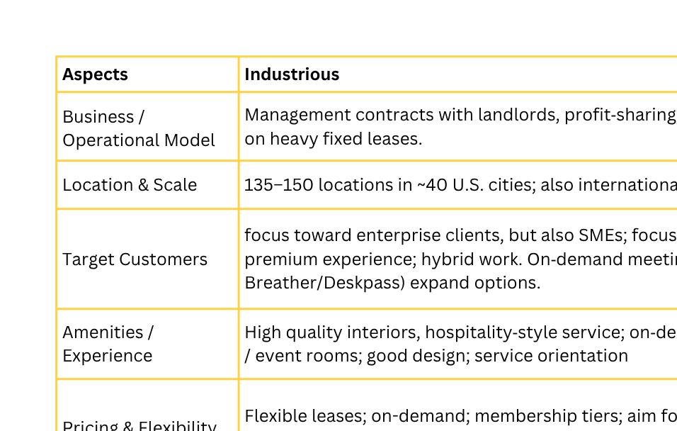
KEY RESULTS
Scalability & Viability Assessment
Is Industrious operating in a favorable and growing external environment ?
Industrious possesses strong internal drivers for scalable growth, including an adaptive culture, effective leadership, and a skilled, motivated workforce. Operational efficiency is reinforced by standardized processes and technology-driven workflows. Robust internal communication ensures alignment, while a customer-centric focus, advanced CRM, and service excellence enhance retention.

Slide 10
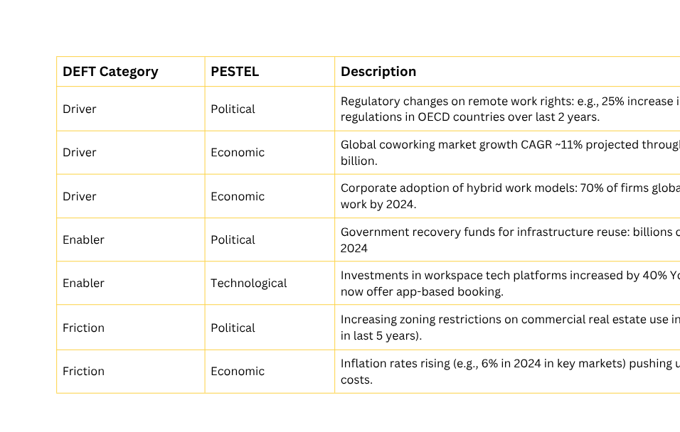
KEY RESULTS
Scalability & Viability Assessment
Trend audit to identify and analyze the key trends Industrious builds on.
How strong and defensible is Industrious’s position compared to competitors?
Industrious operates over 160+ locations in 65+ cities globally, achieving extensive geographic reach and dense national coverage with steady growth—making it a core player in the U.S. and a rapid expander in Europe.
Its asset-light management contract model allows scalable expansion with less financial risk, especially as part of CBRE after its $400M acquisition, giving it a strategic advantage versus lease-heavy competitors.
Industrious sets itself apart with premium spaces validated by WELL Coworking certifications in major metros, emphasizing health-driven design, high-end amenities, and superior operational experience for enterprise clients
As the coworking sector matures and consolidates, Industrious is strengthened by CBRE’s global distribution and robust financial backing, positioning it to capture long-term growth in a market valued at $25.39 billion in 2025 and projected to surpass $62 billion by 2032

Slide 11
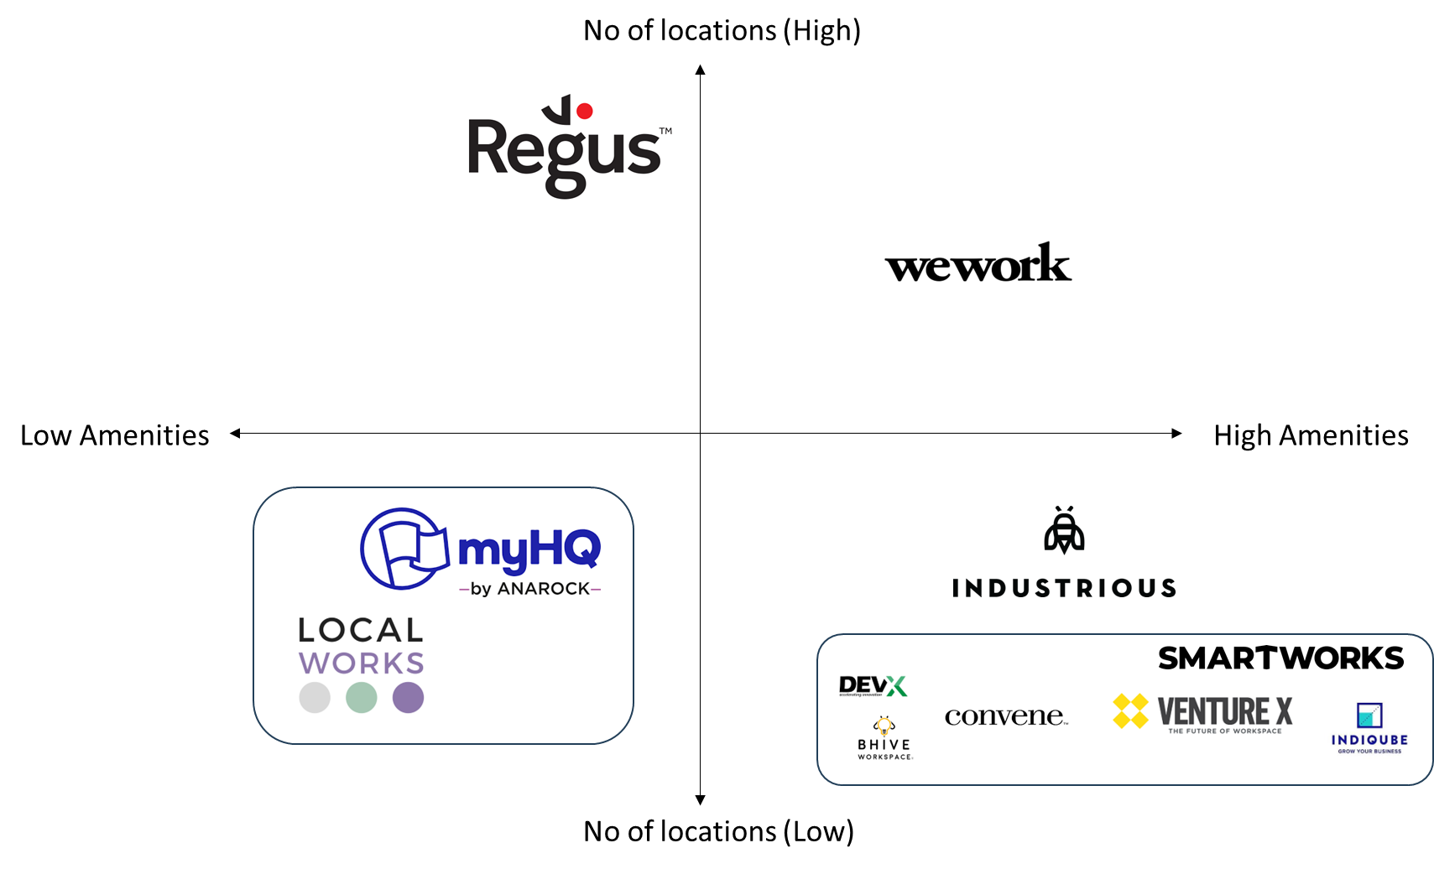
KEY RESULTS
Scalability & Viability Assessment
External actors analysis

Slide 12
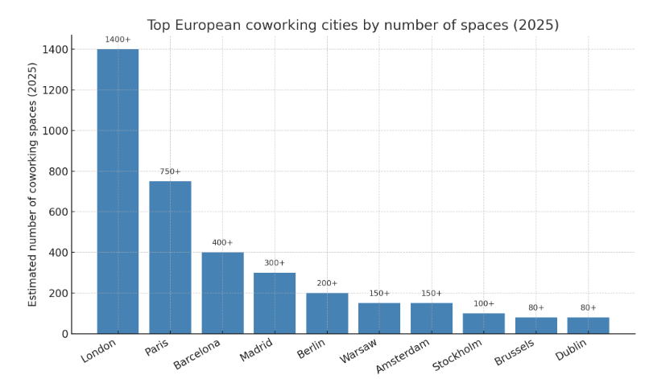
KEY RESULTS
Scalability & Viability Assessment
Workspace-as-a-Service (WaaS) in Europe from regulatory POV
Governments are increasingly investing in the reuse of public buildings to support urban regeneration, tourism, SME competitiveness, and digital access. In Spain, for example, Recovery and Resilience Facility (RRF) funds are being channeled into such areas, which can include the conversion of underused spaces—like former postal offices—into coworking hubs or telecentros.
The UK’s Government Property Agency (GPA) implements flexible workspace frameworks allowing public bodies to buy on-demand WaaS across their estates, promoting smarter working hubs in cities such as Manchester and Birmingham.
National telework laws in countries like France and Finland encourage flexible office usage, while ESG goals in Netherlands cities push corporate tenants to adopt WaaS models that optimize space and sustainability.
Unlike living-as-a-service models like Airbnb, coworking spaces are receiving increasing government support across Europe, including use of public assets. For example, Spain actively promotes coworking in government-owned properties to boost entrepreneurship and local economic development.

Slide 13
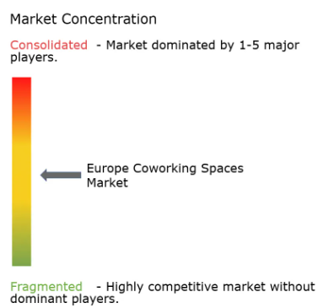
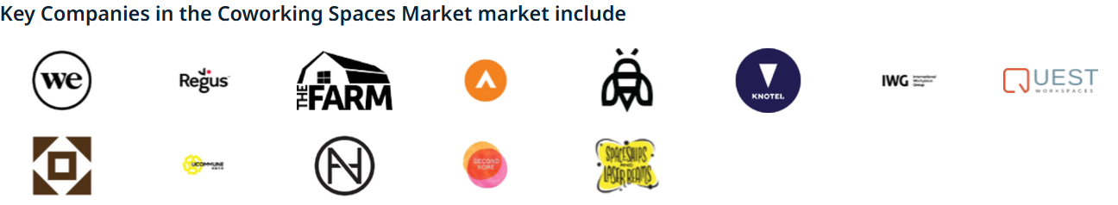
KEY RESULTS
Scalability & Viability Assessment
Is there sufficient and growing demand for Industrious in the industry?
Europe’s coworking sector is valued at USD 7.23B (2025) and projected to reach USD 11.8B by 2030 at a 10.37% CAGR, cementing its role in the office ecosystem.
With 80–85% occupancy rates, coworking spaces outperform traditional offices, driven by hybrid work adoption, SMEs, and freelancers.
Secondary cities like Lisbon, Manchester, Krakow, and Prague are expanding rapidly, while monthly prices range from €325 in Barcelona to €1,700 in Paris.
Driven by the rise of flexible work models, digital innovation, and strong demand for secure, scalable workspace solutions.
Growth further supported by Europe’s commitment to sustainability and advanced workplace technologies.
Over 5 million people
worldwide now work from coworking spaces
Can the internal model and performance deliver viable and scalable growth?
Industrious operates in a favorable, expanding market, with the global coworking sector projected to exceed $25 billion by 2025 and grow at 12–14% annually. Growth is driven by rising freelancing, startups, hybrid work adoption, and corporate demand for flexible office solutions. Evolving customer expectations for personalized, tech-enabled, and wellness-focused spaces align closely with Industrious’s offerings.

Slide 14
ISSUE ANALYSIS
Net Positive Catalyst Assessment
Is Industrious a Net Positive Catalyst?
1. How does Industrious reduce its environmental footprint?
2. How does Industrious embed sustainability into its operations and culture?
3. How does Industrious act as a systemic catalyst for a net positive future?
1.1 Are coworking operations more environmentally sustainable than traditional office methods?
1.2 Would a higher occupancy rate in shared workplaces allow for fewer unoccupied dedicated workplaces?
1.3 Can a specialized business optimize construction for more sustainable buildings?
2.1 Does the design and atmosphere of coworking spaces measurably improve client productivity and satisfaction?
2.2 Can coworking models increase the satisfaction of employees?
3.1 Is Industrious influencing industry norms, regulation, or consumer awareness?
3.2 Could it create an economy of scale allowing companies to spend less on workplaces?
employee experience
resource efficiency
occupancy optimization
sustainable design
design & wellbeing
H5: Coworking environments enhance wellbeing, autonomy, and sense of belonging.
industry influence
H6: Industrious raises sector standards through certifications and purpose-driven culture.
economy of scale
H1: Coworking spaces lower environmental impact through shared infrastructure and higher space utilization.
H2: Higher occupancy reduces unused desks and required floor area.
H3: Industrious supports greener buildings using certified, low-carbon, and adaptive-reuse design.
H4: Well-designed, wellbeing-focused environments improve satisfaction and productivity.
H7: Shared space models reduce workplace costs and improve access to sustainable environments
• 49 kg CO₂e/m² vs 11 kg CO₂e/m² (flex)
• Shared lighting and HVAC
• Less equipment duplication
• Denser space use
• Lower CO₂ from commutes
• Smaller per-user footprint
• ~60 % avg desk use (traditional)
• 20–25 % desk reduction possible
• Fewer idle assets
• Lower energy per employee
• Urban space freed for housing
• 70% sites in green-certified buildings
• Low-carbon materials (LED, bamboo)
• Second-hand furniture use
• Energy savings
• Reduced fit-out waste
• 0.71 correlation (atmosphere & satisfaction)
• +79 % service quality
• Optimized layouts reduce distraction
• Natural light & zoning boost focus
• Design fosters productive flow
• Higher wellbeing vs home or office
• Autonomy increases motivation
• Strong community & meaningful interactions
• Greater satisfaction and performance
• WELL certification; LEED-aligned spaces
• NPS 82 across 40,000+ members
• Purpose-driven campaigns shaping culture
• Increases sustainability awareness in coworking
• Up to 40% lower workplace costs vs. traditional leases
• >80% occupancy and 20% cost savings via tech boost profitability

Slide 15
INDUSTRIOUS’ NET POSITIVITY
Key Results
1. How does Industrious reduce its environmental footprint?
1.1 Are coworking operations more environmentally sustainable than traditional office methods?
Carbon intensity gap (utilization-adjusted). Across ~100 sites, flex averaged 11 CO₂e “units”/m² vs leased 49; on a per-occupier basis leased space was ~3× more carbon-intensive due to unused desks and oversizing. Each unused desk ≈ ~1 t CO₂/year, highlighting why utilization is decisive.
Urban proximity reduces commute CO₂. Swiss data show ~350 kg CO₂/year for urban coworkers vs ~940 kg rural; if all trips shifted to the coworking site, commute CO₂ falls ~10% (location choice is material).
Direct + indirect effects framework. Co-working cuts direct impacts via shared space and travel changes, but indirect/rebound risks exist (extra equipment, added trips, duplicative space) unless operators right-size floor area and avoid inefficient add-ons.
Behavior drives actual energy. Occupant practices (setpoints, plug loads, presence) explain large performance gaps; HVAC + lighting typically >50% of office energy—higher, denser utilization must pair with active controls to lock in savings.
Industrious’ business model structurally supports lower per-occupier emissions and long-term resource efficiency.
Operates under a partnership-based model where it co-manages spaces with landlords rather than leasing them outright.
This approach reduces unused space and repeated fit-outs, cutting embodied and operational emissions compared to typical coworking operators that frequently open and close leased sites.
Achieves a more stable and resource-efficient footprint by right-sizing floor area and sharing infrastructure,
Improvement opportunity: expand transparent tracking of per-user CO₂ performance and share efficiency data publicly to benchmark sustainability progress.

Slide 16
INDUSTRIOUS’ NET POSITIVITY
Key Results
1. How does Industrious reduce its environmental footprint?
1.2 Would higher occupancy in shared workplaces reduce unoccupied dedicated workplaces?
Dedicated desks underused. Traditional offices rarely exceed ~60% occupancy, leaving ~40% of desks idle, driving wasted energy and embedded carbon.
Right-sizing via sensors & booking. Example: a 100-person company → 80 workstations (-20%) by tracking presence and shifting to reservations. Capex for sensors/apps is ~€100 per desk, <1% of annual desk cost, with meaningful real-estate savings.
Smaller footprint = lower ops energy. Less area to heat/cool/light reduces energy use. Hybrid work further cuts commute emissions when paired with local coworking access.
1.3 Can a specialized business optimize construction for more sustainable buildings?
Operate for performance. Instant Group flags three levers: energy (green tariffs, night audits, setpoint discipline), supply chain (screen suppliers for GHG targets), and data (shared, transparent metrics). These push down operational energy that operators directly control.
Retrofit > new build.
Tactics in practice for lowering both embodied and operational loads. Eco-conscious operators deploy LED, smart controls, low-tox finishes, bamboo/renewable materials, bike storage, recycling & smart tech.
Collaborative approach positions Industrious ahead of many coworking firms in advancing low-carbon and circular workspace design.
Working directly with landlords allows Industrious to influence retrofit and design decisions early.
Adaptive reuse rather than new construction, significantly lowering embodied carbon while modernizing existing assets.
Shared capital investment with property owners enables sustainable materials, efficient systems, and circular fit-outs without overextending costs.
Improvement: formalize sustainable design guidelines and integrate embodied carbon tracking across projects.
Industrious’ model already embodies the high-utilization principles central to sustainable real estate.
Revenue alignment with landlords incentivizes high occupancy and low vacancy.
Spaces can scale dynamically with demand, avoiding fixed-lease inefficiencies.
Improvement: deploy detailed occupancy analytics across all sites to identify low-use areas and optimize space allocation.

Slide 17
INDUSTRIOUS’ NET POSITIVITY
Key Results
2. How does Industrious embed sustainability into its operations and culture?
2.1 Does the design and atmosphere of coworking spaces measurably improve client productivity and satisfaction?
Atmosphere × satisfaction link. Research shows a strong correlation (~0.71) between coworking atmosphere and client satisfaction, rising to ~0.79 when service quality (design + hospitality) is included.
Design mechanisms. Intentional layouts, task-based zoning (quiet, collaboration, meeting), and quality lighting reduce distraction and improve perceived productivity vs. home settings.
Professional environment effect. Structured, dedicated spaces foster accountability, fewer interruptions, and better amenities (meeting rooms, reliable Wi-Fi), consistently cited as productivity drivers.
Industrious connects operational stability with employee and member wellbeing, and demonstrates how financial sustainability directly enables human-centric, high-quality work environments.
Partnership-based model allows co-investment with landlords in design quality, user comfort, and workplace wellbeing across its network.
Shared funding maintains high design and hospitality standards, directly supporting focus and productivity.
Operational stability enables consistent community programs, wellness initiatives, and social engagement that strengthen belonging and mental wellbeing.
Durable, people-centered communities that align with its net-positive culture goals (unlike operators with volatile lease cycles).
Improvement opportunities:
Systematize wellbeing and satisfaction tracking (e.g., NPS, engagement, focus metrics) and include these outcomes in sustainability reporting to demonstrate social impact over time.
Scale structured wellness programs: while local wellness and community events exist, Industrious could standardize company-wide wellbeing frameworks (mental health partnerships, active-commute incentives, air quality monitoring) across all markets.
2.2 Can coworking models increase the satisfaction of employees?
Wellbeing advantage vs home/HQ. Large-scale HBR studies show coworkers experience greater social fulfillment due to autonomy in choosing where and with whom to work. Coworking enables relational job crafting, improving meaning and satisfaction
Mechanisms that matter. Autonomy (choice of zone/people), community interactions, and varied amenities underpin higher satisfaction and can translate into engagement/retention gains when adopted at scale.

Slide 18

ISSUE ANALYSIS
Net Positive Catalyst Assessment
3. How does Industrious act as a systemic catalyst for a net positive future?
WELL Coworking Rating (UK)
Recognized for health, comfort & sustainability in workspace design.
3.1 Is Industrious influencing industry norms, regulation, or consumer awareness?
Industrious became the first coworking provider to obtain the WELL Coworking Rating (7 sites across London & Manchester), now part of a global network of 250+ locations in 65 cities (Propmodo, 2023).
This recognition sets a new industry benchmark for health and wellness in flexible workplaces.
Through collaboration with The Instant Group, Industrious’ WELL-certified spaces are now searchable across 350,000 flexible workplaces, improving transparency and awareness among workspace users (Propmodo, 2023).
Its NPS of 82 among 40,000+ members demonstrates world-class satisfaction, reinforcing the brand’s leadership and positive reputation (Industrious, 2023).
Brand initiatives such as “Industrious You” and Powering Purpose emphasize human-centered, community-oriented culture, influencing expectations across the coworking industry (Industrious, 2023).
3.2 Could it create an economy of scale allowing companies to spend less on workplaces?
The coworking model allows businesses to avoid long-term leases and benefit from shared utilities and amenities, significantly reducing fixed overheads per user (Office Hub, 2023).
Scaling across multiple locations enables Industrious to negotiate supplier deals, standardize operations, and achieve economies of scale (Coworking Resources, 2023).
With occupancy rates above 80%, and ~20% lower operational costs through technology and centralized management, Industrious delivers a profitable, efficient, and sustainable workspace model (FinModelsLab, 2023).
Supported by CBRE’s full acquisition in 2025 (valuing Industrious at ~$800M), the model has proven its economic resilience and scalability (CBRE, 2025).
“At Industrious, we’re building a new kind of workplace, one which puts employees’ needs at its center and empowers them to choose where and how they work.”
JAMIE HODARI,
COFOUNDER & CEO
Industrious sets a replicable model for the real-estate sector, shifting from rent-driven to performance-driven value creation, advancing both economic and environmental sustainability.

Slide 19

ANSWER
to hypothesis
Industrious qualifies as a financially viable, scalable, and net positive catalyst. Its partnership-based model enables profitable growth while advancing social and environmental sustainability in the workspace industry. By combining flexible design, wellbeing-centered service, and adaptive reuse of real estate, Industrious demonstrates how the coworking model can create long-term shared value for people, planet, and profit.
Business Model Mechanics
Asset-light scalability: Management agreements with landlords reduce fixed costs and capital exposure, allowing rapid replication across 160+ locations in 65+ cities.
High utilization, low carbon: Shared infrastructure achieves 11 kg CO₂e/m² vs 49 kg CO₂e/m² in traditional offices—~4× lower per-occupier emissions.
Adaptive reuse priority: 70 % of sites located in green-certified or retrofitted buildings; focus on WELL and LEED standards.
Technology integration: Digital booking, analytics, and energy monitoring systems enable occupancy optimization and operational efficiency.
Human-centered operations: Community managers and wellness programs strengthen satisfaction, retention (60–80 %), and productivity.
Catalytic Effects on the Industry
Environmental impact: Shared infrastructure and retrofit-first approach reduce construction waste, embodied carbon, and commuting emissions.
Social value: WELL-certified spaces enhance wellbeing, autonomy, and belonging—creating healthier, more inclusive workplaces.
Economic inclusion: Shared leases cut costs by ~40 %, making premium work environments accessible to SMEs and startups.
Industry influence: First coworking provider with the WELL Coworking Rating, setting new norms for health and sustainability.
Investor validation: Acquisition by CBRE (2025) confirms the model’s resilience, credibility, and global scaling potential.
Industrious exemplifies a Net Positive Workplace Catalyst—transforming commercial real estate from static, high-emission assets into adaptive, wellness-driven ecosystems. Its model integrates economic scalability, social wellbeing, and environmental efficiency, positioning it as a template for the future of sustainable, human-centered workspaces.

Slide 20
APPENDIX

Slide 21
APPENDIX - WORKPLAN
Industrious’s scalability and viability.
Objective
Is Industrious operating in a favorable and growing external environment?
Does Industrious have the internal model and performance to deliver viable and scalable growth?
Research Methodology
H1 : Coworking costs more, but profitable.
H2 : Standardize model, adapt to local needs.
H3 : High demand for flexibility, location.
H1 : Satisfied customers pay higher rates.
H2 : Trends influence occupancy and revenue.
H3 : High retention needed for sustained profit.
Research Methology
Market Trends : Cushman & Wakefield, Fortune Business Insights, Mordor Intelligence
Competitor Mapping : Workplace, Regus
Financial ratio analysis
Time/cost comparison
Innovation
Expected deliverables
Market trends table
Competitor benchmark matrix
Financial indicators table
Efficiency benchmak slide

Slide 22
APPENDIX
Estimations
FY 2025 | Revenue: $1.5B
FY 2030 | Revenue: $2.66B
Operating Margin: 6%
Operational profit: $90M After-tax earnings: $68M
Context: Initial consolidation phase following CBRE acquisition, focusing on location optimization and cost structure refinement
Operational profit: $292M | After-tax earnings: $219M
Context: Premium positioning consolidated with specialized offerings commanding higher pricing, achieving upper-quartile industry margins
Industrious Financial Performance Estimations: Revenue, Profitability, and Growth Trends (2025-2030
FY 2026 | Revenue: $1.68B
FY 2027 | Revenue: $1.88B
FY 2028 | Revenue: $2.11B
FY 2029 | Revenue: $2.37B
Operating Margin: 8%
Operational profit: $134M After-tax earnings: $101M
Context: Occupancy stabilization achieved, leveraging 160+ locations with improved utilization rates targeting industry benchmark of 65%+
Operating Margin: 9%
Operational profit: $169M After-tax earnings: $127M
Context: Revenue diversification kicks in through meeting room bookings, virtual offices, and premium suite offerings driving margin expansion
Operating Margin: 10%
Operational profit: $211M After-tax earnings: $158M
Context: Platform maturity reached with consistent 10% margins aligning with industry profitability benchmarks for established coworking operators
Operating Margin: 10%
Operational profit: $237M | After-tax earnings: $178M
Context: Geographic expansion into secondary markets and enhanced community engagement driving sustained member retention

Slide 23
APPENDIX - VALUE CHAIN
Recent Deal - CBRE fully acquired Industrious for nearly $1 billion, confirming the long-term confidence in its flexible workspace model. The acquisition aimed to integrate Industrious into CBRE’s Building Operations & Experience (BOE) platform, strengthening global scalability and client reach.
(https://ir.cbre.com/press-releases/detail/245/cbre-group-to-acquire-industrious-create-new-business)
A great Occupancy - Industrious reported 90% average occupancy for mature locations with less than 1% net churn, reflecting strong retention and revenue predictability. This data underscores the efficiency of its management-agreement model, which minimizes fixed costs. High occupancy across diverse markets demonstrates operational maturity and customer loyalty.
(https://blog.industriousoffice.com/blog/industrious/industrious-raises-80-million-in-series-d)
Premium Hospitality Style - The acquisition valued Industrious at approximately $800 million, positioning it among the top global coworking players. WSJ underlined that Industrious’s premium, hospitality-style approach differentiates it from competitors like WeWork. Its steady growth and hybrid model align with post-pandemic demand for flexible, service-based offices.
(https://www.wsj.com/real-estate/commercial/giant-commercial-property-firm-goes-all-in-on-co-working-with-new-deal-f0b036fe)
Annual Revenue - In flagship buildings, Industrious achieved >95% occupancy and over $2M annual revenue from amenities. This illustrates how its focus on experience — from design to service quality — drives profitability. The company positions the workplace as a lifestyle destination rather than a functional necessity.
(https://blog.industriousoffice.com/blog/industrious/the-choice-to-show-up-how-industrious-is-reimagining-the-office-as-a-destination)

Slide 24
APPENDIX
Scalability & Viability Assessment
Financial
1 - FORM 10-Q : CBRE GROUP, INC.
2 - “CBRE Group to Acquire Industrious ...” https://ir.cbre.com/press-releases/detail/245/cbre-group-to-acquire-industrious-create-new-business
3- https://www.optixapp.com/blog/european-coworking-market/#:~:text=The%20European%20coworking%20market%20is%20worth%20USD%207.23%20billion%20in,SMEs%2C%20freelancers%2C%20and%20corporations.
4 - https://www.mordorintelligence.com/industry-reports/coworking-spaces-in-europe
5 - https://archieapp.co/blog/largest-coworking-companies/
Market
1 - Statista : “Coworking space worldwide...” https://fr.statista.com/statistiques/644157/coworking-nombre-bureaux-partages-monde/
Net Positivity Assessment
Environmental Sustainability of Coworking- The Instant Group ; ResearchGate ; arXiv
Reducing Commute and Energy Impacts- ResearchGate
Optimizing Occupancy in Shared Workplaces- telelogos.com ; Ubigreen
Smart Sensors and Right-Sizing- Ubigreen
Circular & Adaptive Construction Practices- The Instant Group ; Allwork.Space ; Nexudus
Performance-Based Sustainability- The Instant Group+1
Coworking Design and Productivity- ResearchGate ; Havn Co.+1 ; 500 SIXTH
Environmental Comfort & Wellbeing- Havn Co.+1
Employee Wellbeing in Coworking- Harvard Business Review
Community & Engagement Mechanisms- Harvard Business Review

